Slide 1








Reinforcement Learning for Traffic Signal Control: Comparison with Commercial Systems
Alvaro Cabrejas Egea*†, Raymond Zhang*‡ & Neil Walton*^
* The Alan Turing Institute, † University of Warwick, ‡ University of Paris-Saclay, ^ University of Manchester
Notes:
Hello, my name is A.C.E and in this video I will presenting our paper Reinforcement Learning for Traffic Signal Control, A comparison with commercial systems. This work is the result of a collaboration between the Alan Turing Institute and the Toyota Mobility Foundation, which involved Raymond Zhang, Neil Walton and myself.

Slide 2
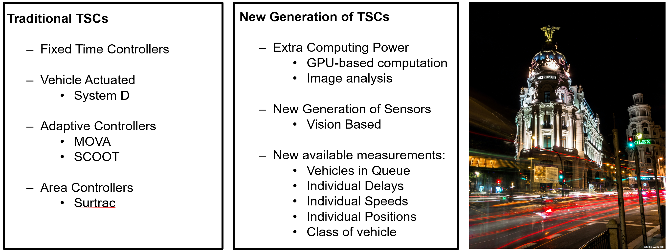
Times of Change in Traffic Signal Control
Notes:
Winds of change are blowing in the field of traffic signal control.
Globally, populous cities are looking for data-intensive solutions that mitigate their congestion and mobility issues, in a moment when there is little appetite for big investments to create large new infrastructures.
Effective traffic signal control is one of the key issues in Urban Traffic Control (UTC), effectively deciding how the available resources (green time) in our urban travel networks are allocated.
The efficiency associated with this allocation has an important impact on travel times, harmful emissions and economic activity.
First, fixed time controllers, and later, adaptive systems have been used to further optimise the global traffic flow in our cities.
Recent increases in available computing power have enabled the advent of a brand-new generation of machine-learning based Traffic Signal Controllers, which are becoming very serious contenders in this race, but there are few comparisons between them and currently used commercial systems in the literature.

Slide 3
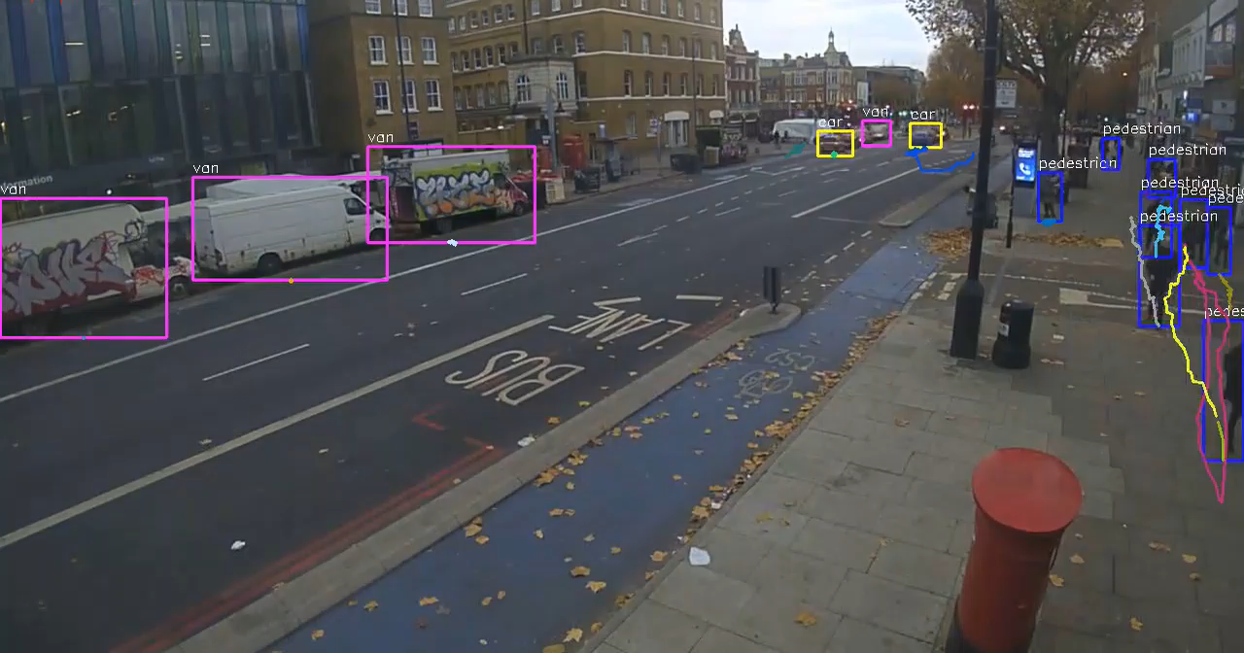
Notes:
These new controllers are empowered by intelligent vision-based sensors that can perform real-time image analysis, allowing us to obtain measurements that previously used induction loops could not dream of.
These measurements include, but are not restricted to queue lengths and counts, individual vehicles’ speeds and delays, individual delay measurements and even classification by class of vehicle.
This is extremely useful since this opens the doors to further research to develop products that can deal with multiple modes of transportation in our streets, paving the road for modal prioritisation based approaches, in which, for example, public transport or bus lanes could be given higher priority than individual vehicles in terms of traffic management.
Other alternatives could involve different traffic light settings for different requirements, such as aiming to minimise pollution, or quickly clearing an area after a special event, such as a football match.
What you are seeing on the screen now, is the analysis of one such sensor, developed by one of our partners, Vivacity Labs, which was being performed in real-time in Manchester, UK.
The system has a high level of privacy by nature, since the detection, classification and tracking is done on the sensor itself and the video is discarded after the mobility features are extracted.
This newly available data, of extreme high quality and granularity, is allowing us to generate new controllers based on Reinforcement Learning.

Slide 4
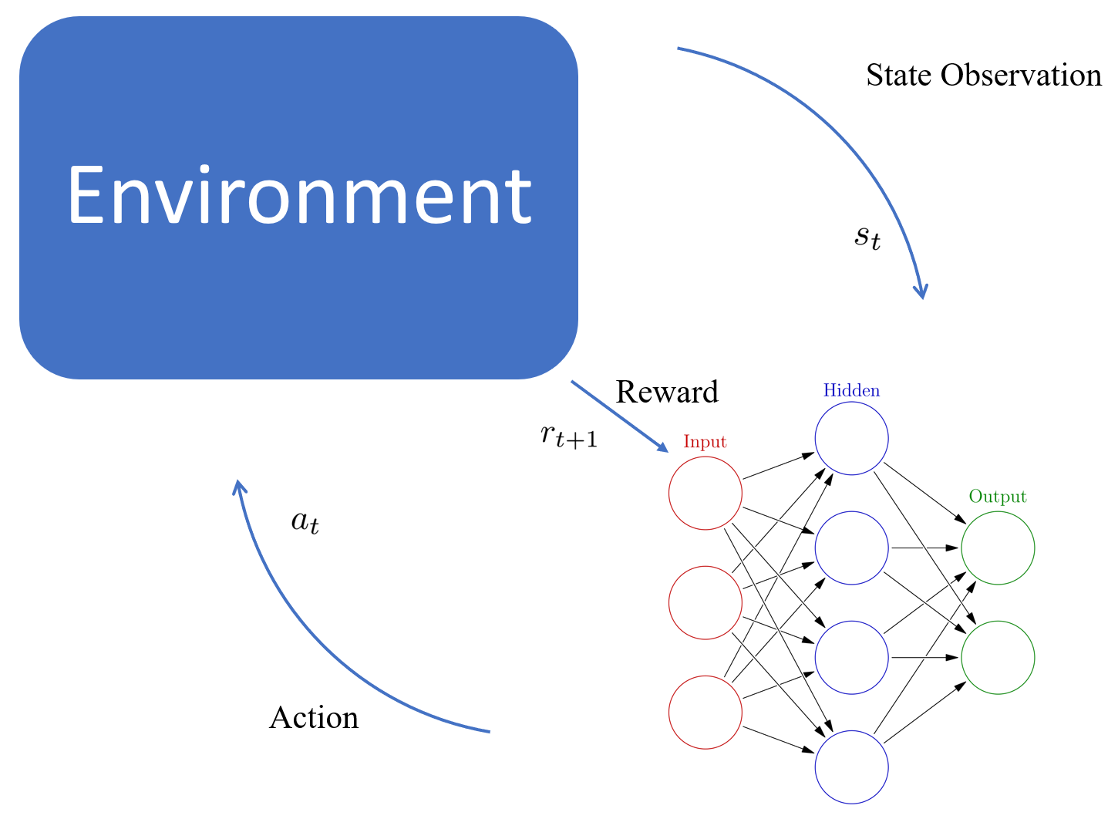
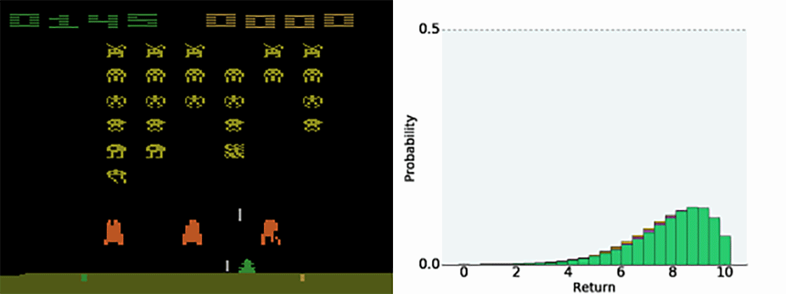
Reinforcement Learning
Notes:
Reinforcement learning is a sub-field of machine learning that deals with how independent actors can learn in unknown environments for which no prior information is given.
The agents learn by repeatedly interacting with the environment. First they get an encoding of the state of the environment, which they use to generate a suitable action that maximises the expected return. Once the action has taken it’s effect, a reward signal informs the agent of how this action has contributed towards completing the task.
Over time, these repeated interactions allow the agents to get an approximation of how their actions influence the system, and what are the best course of action for the execution of a task.
Different approaches to reinforcement learning do this approximation differently, in our case, we will be using deep neural network.
Overall, RL has gained traction in the last few years, achieving high levels of success in highly difficult tasks such as playing Atari Games, the game of Go and even Starcraft, and it is now starting to be deployed in the real world.

Slide 5
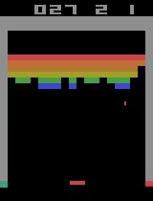
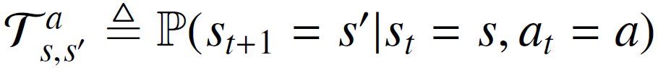
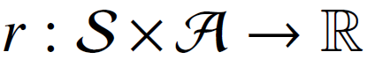
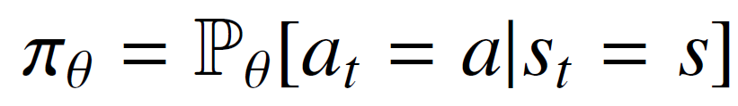
Problem Framed as a Markov Decision Process Defined in terms of a 5-Tuple (S, A, T, r, γ): 1. Space of possible states: S 2. Space of possible actions: A 3. Transition function: 4. Reward function: 5. Discount Factor Agent Policy:
Reinforcement Learning
Notes:
In Reinforcement Learning, the environment is typically stated as a Markov Decision Process.
These processes are defined by a 5-tuple composed of:
The set of possible states of the environment
The set of all the actions available to the agent
A stochastic transition function capable of generating the next state, after an action is taken in the current state.
A reward function that assigns a scalar value to the transition, providing feedback about how suitable the last action was.
A discount factor that tunes how far into the future the agent is seeking to optimize.
The general purpose of a reinforcement learning agent is to learn an optimal or near-optimal policy, parametrised by the weights vector in the neural network at its core, theta, that maps states to actions.

Slide 6
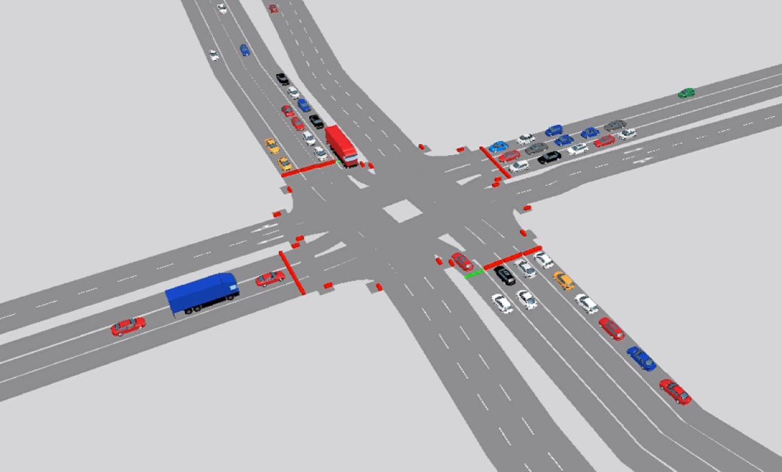
RL Agent Components: - State: Queue length + signal state - Actions: Non-conflicting green stages (6s + 3s + 3s+…) - Reward: Negative sum of queues - Function Approximation: Deep Neural Network - Discount Factor: 0.95 Training Demand: 400 veh * lane / hour Testing Demand: Variable [400-1000] veh * lane / hour
Reinforcement Learning Agents
Notes:
In our case, the agents that were deployed to control traffic signals at intersections were composed of:
The state representation, encoded by the queues in the incoming lanes plus the current green phase.
The available actions, defined as the combinations of green lights that the agent is allowed to choose from. Initially an action will be implemented for 6 seconds, and once it is over, the agent is free to extend it in increments of 3 seconds. There is no in-built limitation as to how many times the same action can be extended, leaving it for the agent to decide.
The reward function that will be the negative sum of queues, aiming to minimise the amount of vehicles stopped while waiting to cross the intersection.
The reward function approximation, which will be done using a deep neural network.
And lastly, the discount factor that we set to 0.95 with the aim of performing long term optimisation.
This specific value is often selected in the field.
However there is a discussion to be had for the application of traffic signals, since there is a limit in how far ahead will current actions have an effect over the traffic flow.
More specifically, there is no sense in optimising beyond the point when an intersection becomes clear of waiting cars, or, in other words, there is a certain level of demand, below which long term optimisation is not required, and greedy optimisation can obtain the best results.
Finding this specific demand level and its corresponding discount factor is left for future research.
The demand during the training procedure was set to 400 vehicles per lane per hour and the demand during the tests was variable, to test the extrapolation abilities of the agents.

Slide 7
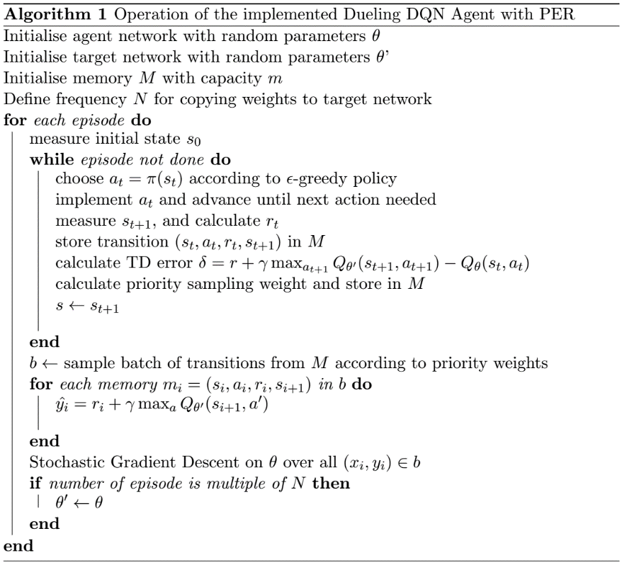
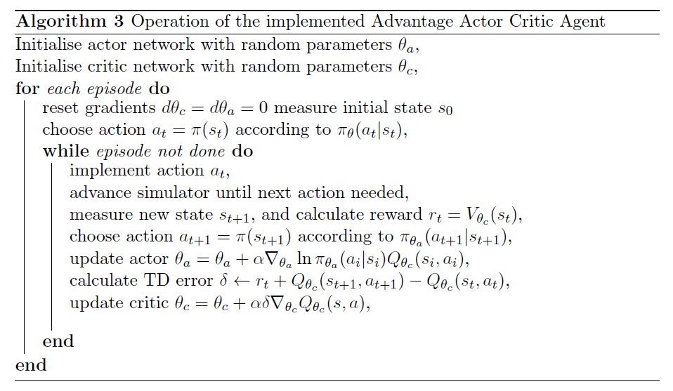
Reinforcement Learning Agents
RL Agent Training: - Value Based: 400 episodes x 1 hour - Policy Based: 100 episodes x 1 hour
Notes:
The agents tested in this paper can be categorised in 2 groups.
On one side we have the value-based agents, based on the Deep Q Network Paradigm, and on the other we have the policy-gradient methods based on the Advantage Actor Critic paradigm.
While the first group tries to learn the action-value pairs (understood as the expected discounted return (the sum of the rewards over time), after choosing a certain action in a given state;, the second group directly maps states to action probabilities and refines this probability distribution over actions as times passes.
While I will not go into the specific details of the algorithms here for time reasons, I will be happy to answer any questions about them after the presentation.

Slide 8
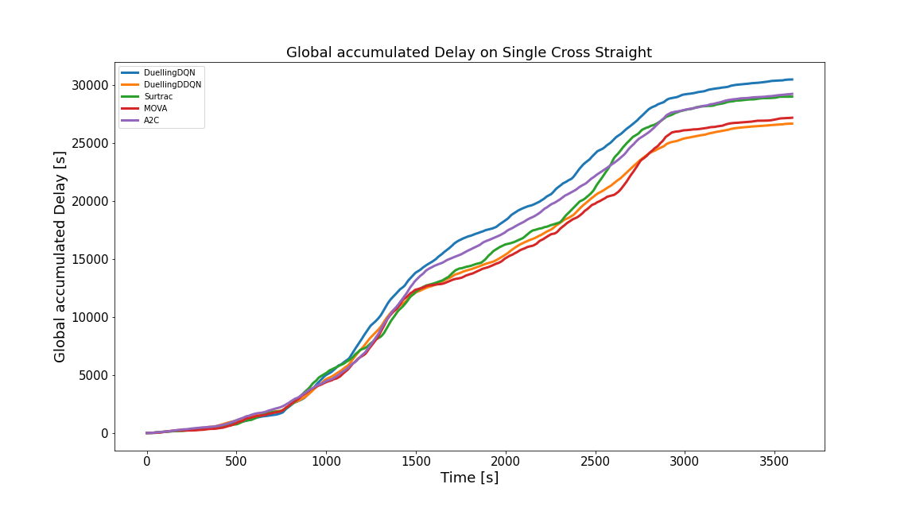
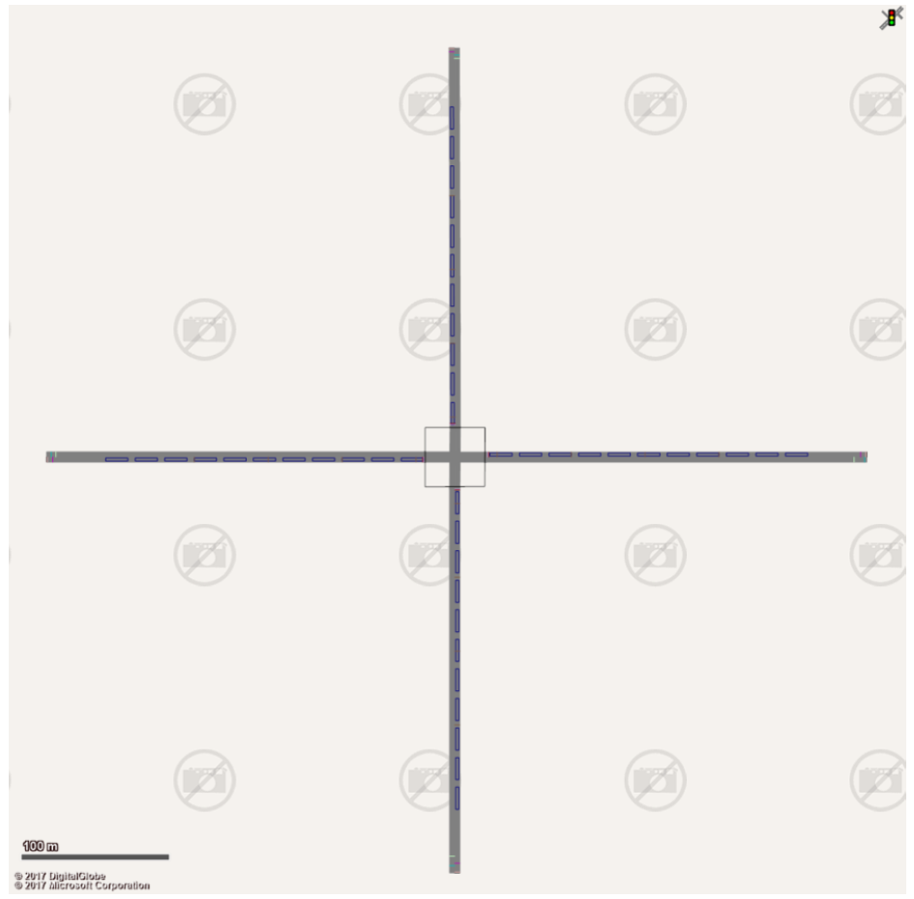
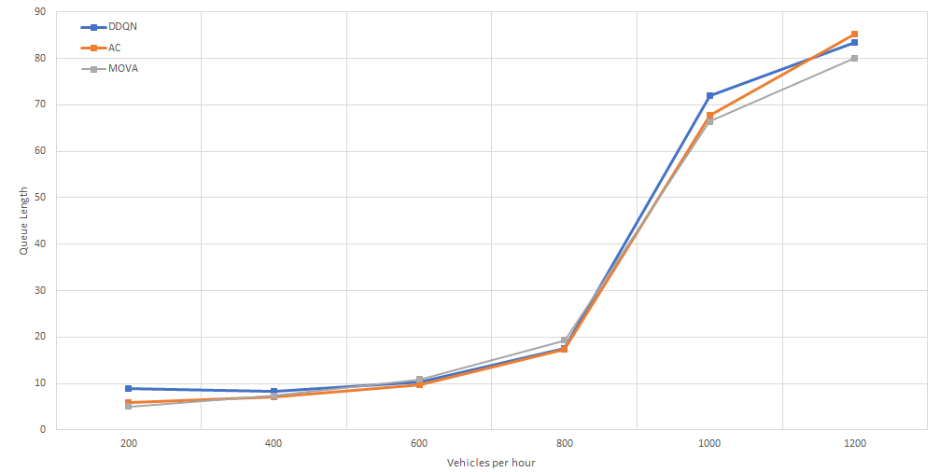
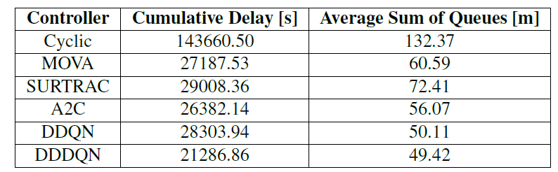
Results Cross Straight
Notes:
Our first experiment took place in a simple map with 1 lane in each direction without allowing turning.
In this case the traffic controller has 2 different phases.
Here our RL agents were compared against several other systems currently in use.
We find that the best optimised fixed controller is outperformed by all the adaptive controllers under variable demand.
Amongst this class, while RL agents obtain the best results, MOVA provides similar performance, although without a lot of difference between them given the simplicity of the model.
Within the RL agents, we found that DQN-based agents outperformed the actor-critic, so going forward we will focus on these.

Slide 9
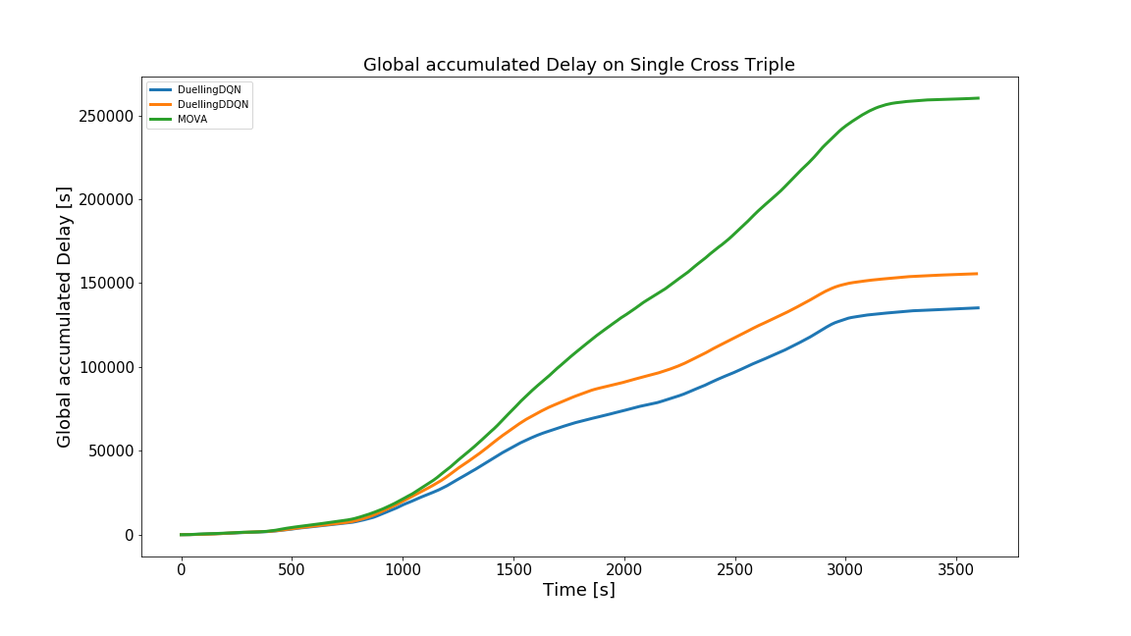
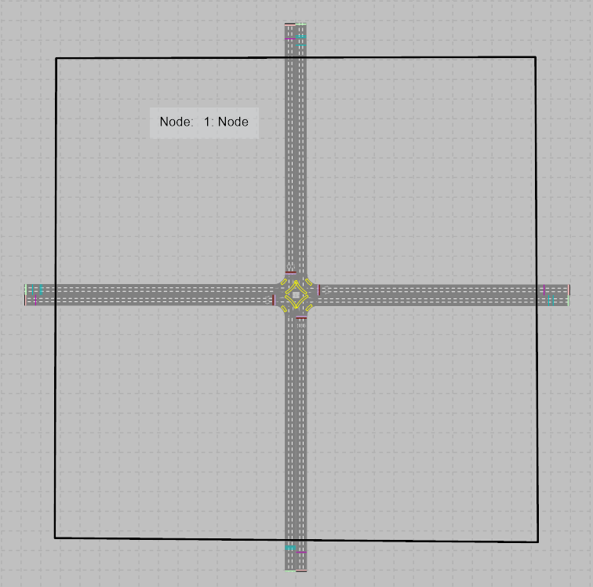
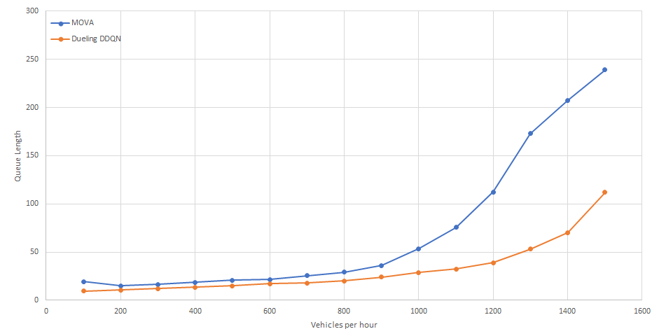
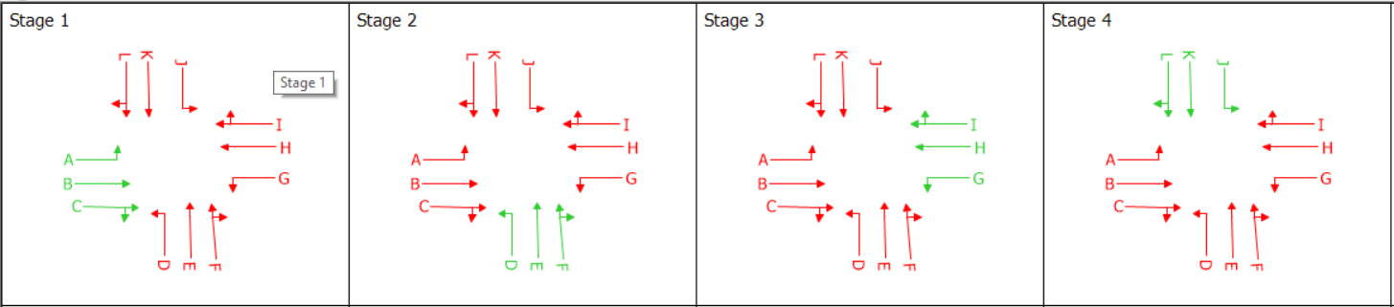
Results Cross Triple I
Notes:
However, when we move to a more complex intersection with 3 incoming lanes per direction, turning allowed and 4 available phases, we find that even MOVA is outclassed, for all variable demand levels as you can see in the top right, as well as for all fixed demand levels tested, as you can see in the bottom right.
The difference in this case is stark, with our agents generating less than half of the delay for drivers that MOVA generates.

Slide 10
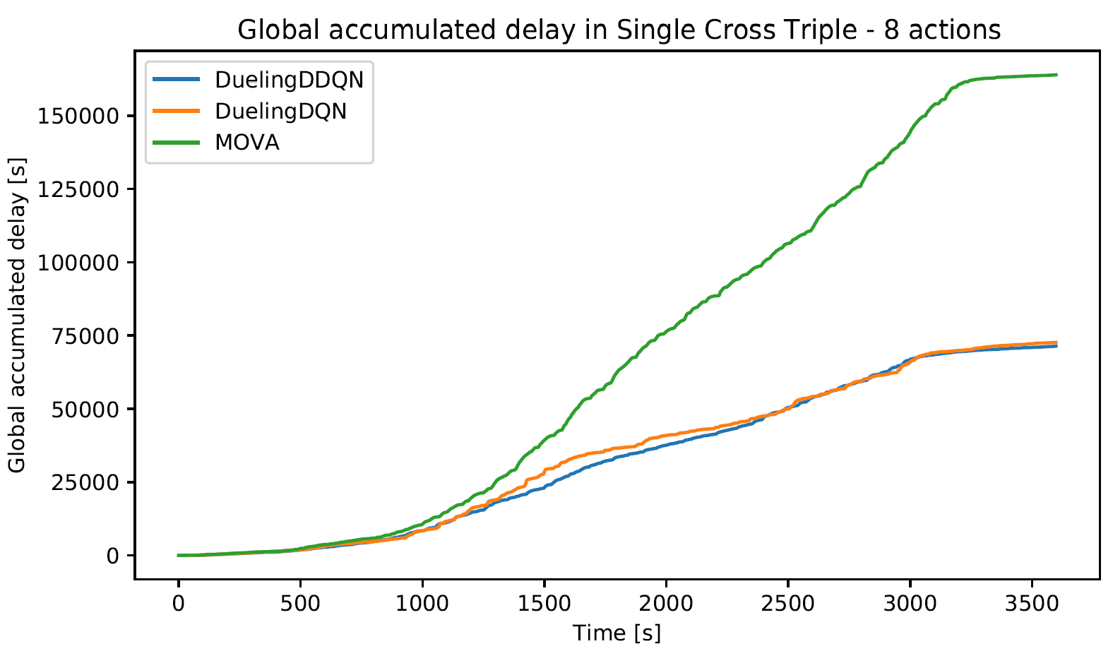
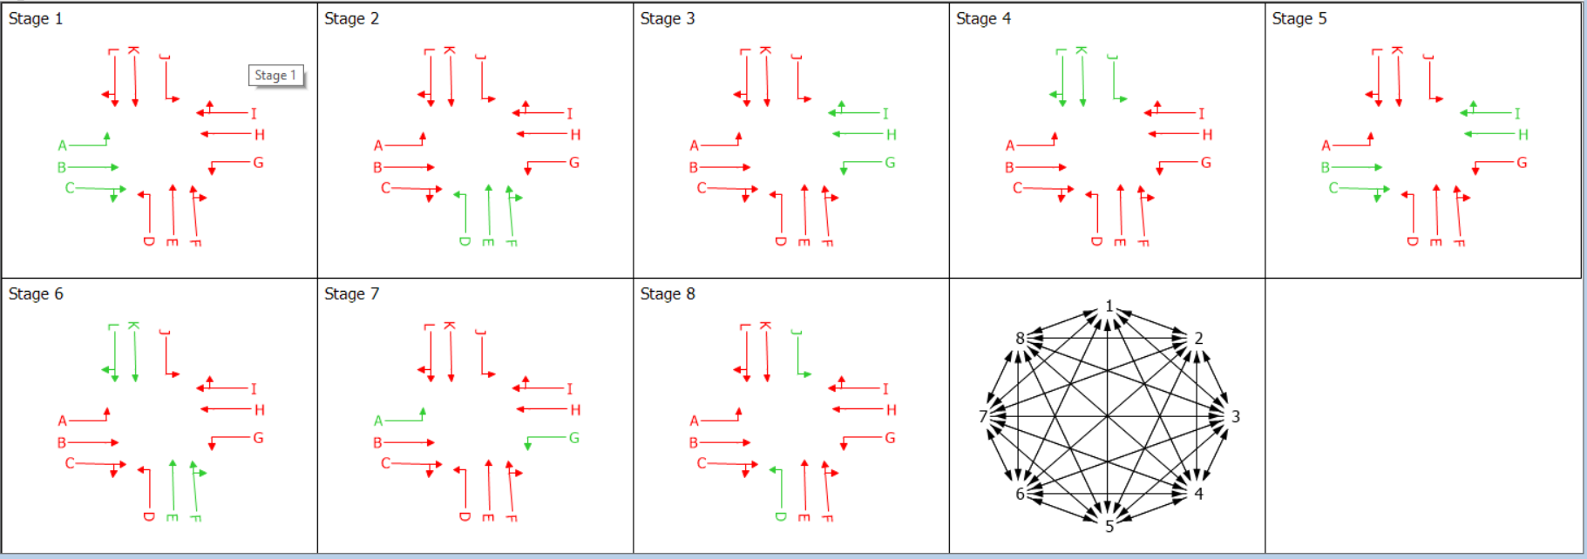
Results Cross Triple II
Notes:
Next, we take the same map, and repeat the experiment while making all actions available to the agents.
In this scenario, we maintain the three incoming lanes per direction, and make all 8 phases available for the agents to select.
Here, no specific stage order is enforced, leaving them for the agent to choose which lights turn green and for how long.
We find that while both approaches increase their performance due to the larger pool of available actions, the gap in performance between MOVA and the RL agents is increased, with the DQN agents now generating less than half of the delay generated by MOVA.

Slide 11
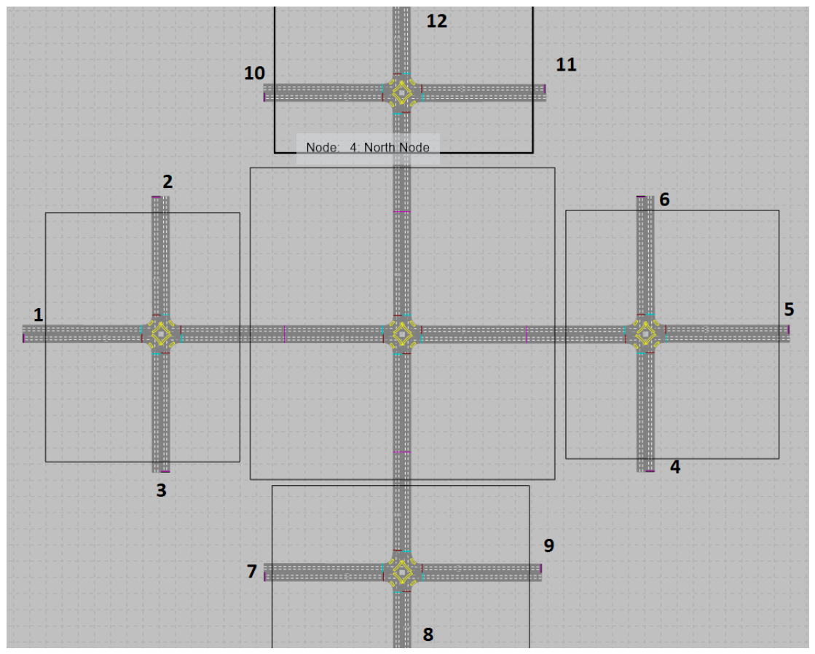
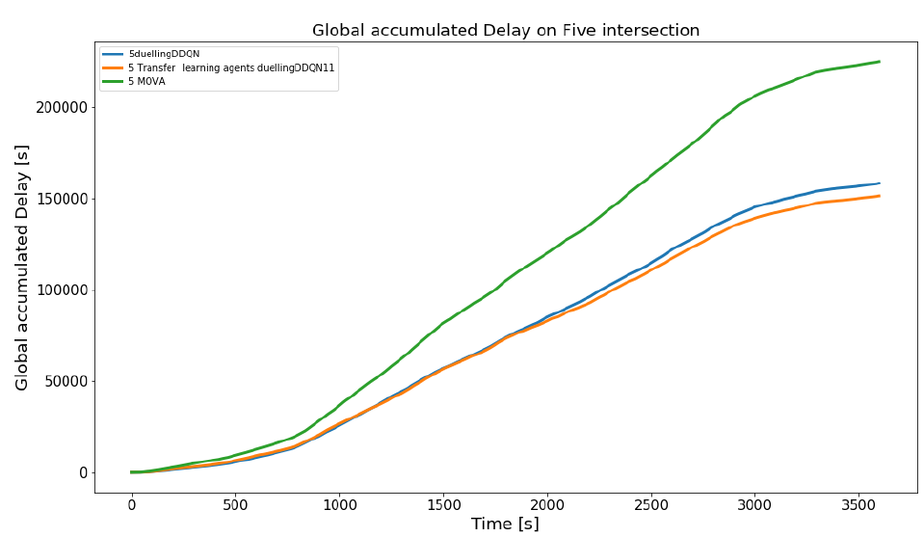
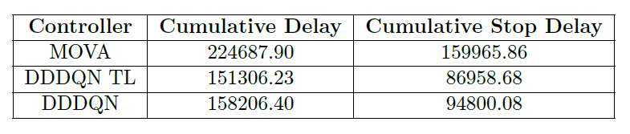
Results Five Intersections
Notes:
As an extra experiment, we wanted to test how far we could push the performance envelope of the agents.
To this end, we took the agent from the previous experiment, cloned it 5 times and gave it control of the intersections you see on screen with the aim of testing its transfer learning and interaction abilities.
At the same time, we trained another collection of 5 agents directly on the job.
It is important to note that communication between RL agents is not allowed, while the MOVA intersections are linked.
This difference in the existence of a coordination effort explains why the gap in performance between MOVA and RL is reduced when compared with the last experiment.
The most interesting thing we found, is that the Transfer Learning collection of agents outperformed the agents trained on the job.
This sheds light into the importance of the training process, since the main difference between the 2 groups is in the central intersection.
What we see here, is that the effective training time of the central agent is lower than those surrounding it.
This is unintuitive since the actual training time is the same. However, the quality of training counts, and while the agents in the edges of the models learn, they will often take suboptimal choices, meaning that the traffic flows that the central agent is trying to learn on, are not really representative of what would be observed should the surrounding agents make optimal choices.
In other words, the central agent cannot be effectively trained, until those agents that affect the traffic it will receive are trained too.

Slide 12
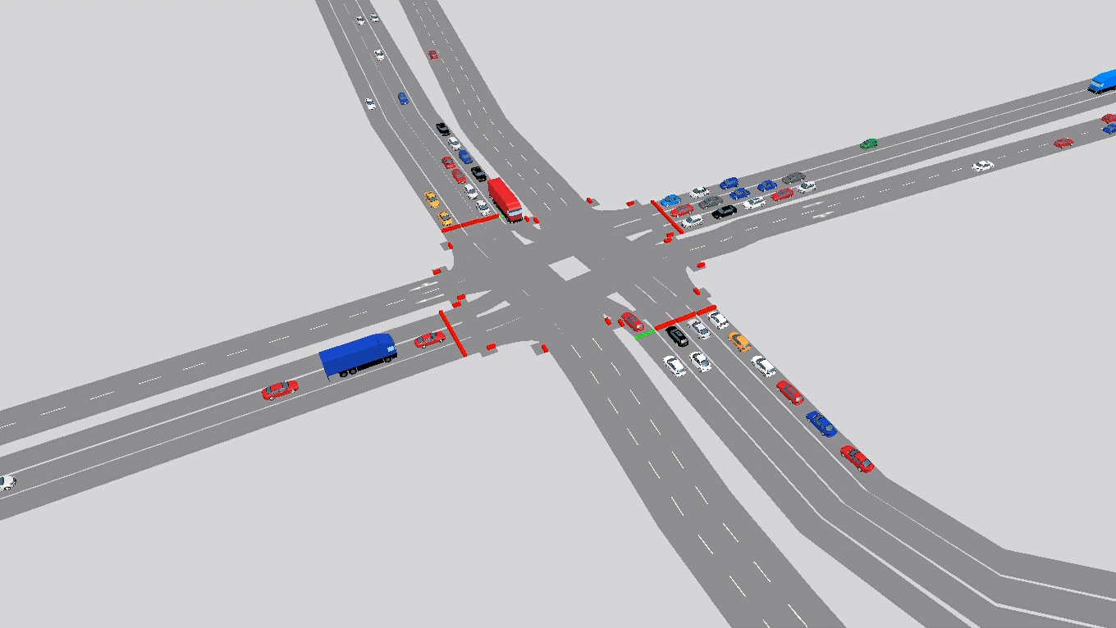
Notes:
In the video now playing, you can observe one of our agents controlling a very complex intersection modelled in Vissim.
As you can see the agent is fully capable of preventing congestion from arising, being able to skip stages or change them at will to improve the traffic flow.
Throughout this presentation we have presented some evidence of how RL-based traffic controllers are capable of outperforming traditional fixed-time and adaptive methods.

Slide 13
THANKS FOR YOUR ATTENTION For more info: acabrejasegea@turing.ac.uk

